Slide 1
Progress Report
Faculty
No Success Coach Assigned

Slide 2
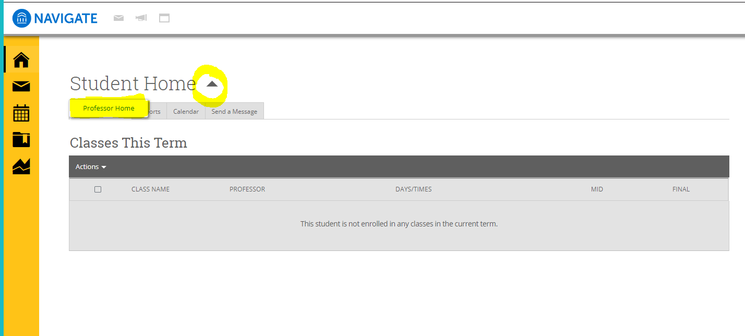
Faculty
Log-in to your portal at wsutech.edu
Choose the icon at the top-Navigate
Click on the down arrow
Choose Professor Home

Slide 3
Faculty
Choose the class you would like to complete a Progress Report
Click Progress Report on the left side

Slide 4
Faculty
Click individual checkbox next to individual name to put the comment on
For Example: If you have three students that you want to make the same comment on you can choose multiple students at once. Otherwise you will choose each student individually

Slide 5
Faculty
Click on Actions arrow
Choose Create a New Progress Report

Slide 6
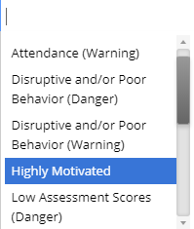
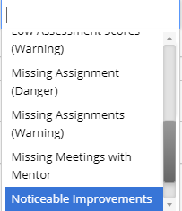
Faculty
Choose Yes
Click on the Alert Reason box and choose the one or more that apply to the student or students
Absences-fill in if applicable (not required)
Current Grade- Not required
Comment-Not required (next slide will show the message the student will get based on the alert chosen)
Student will get an e-mail defining the next step.

Slide 7
Attendance Danger
Email to student –Please contact your instructor to discuss your attendance. If you need to drop your class please contact your Advisor.
Alert-Emails to Success Coach (Tavis, Ashley, Sylvia)
Attendance Warning
Email to student- You have missed a large portion of this class. Please contact your instructor to discuss your future in this class. If you need to drop your class please contact your Advisor.
Alert-Emails to Success Coach (Tavis, Ashley, Sylvia)
Disruptive and/or Poor Behavior (Warning)
Email to student- For you to be successful in this class you will need to make sure you are not disruptive in class. Please make sure you are not on your phone or device during classroom time unless otherwise instructed. If you need further explanation please contact your instructor during office hours.
Alert-Only goes to the student
Disruptive and/or Poor Behavior (Danger)
Email to student-Does not get one
Alert- This student has been flagged by his/her instructor due to disruptive behavior. (Sent to Success Coach and they will forward on to Dean of Program)
Highly Motivate
Email to student- Thank you for taking an active part in discussions and classwork!
Alert- Only goes to student
Low Assessment Scores (Warning)
Email to student- Please contact your instructor regarding recent test scores.
Alert-Only goes to student
Low Assessment Scores (Danger)
Email to student- For you to be successful in this class your test scores need to be addressed. Please contact your instructor during office hours to discuss the next steps for you to be successful in this course.
Alert- Emails to Success Coach (Tavis, Ashley, Sylvia)
Missing Assignment (Warning)
Email to student- Please contact your instructor regarding missing assignments.
Alert-Only goes to student
Missing Assignment (Danger)
Email to student- For you to be successful in this course you need to turn in your assignments. Please contact your instructor to discuss the next steps in this class.
Alert- Emails to Success Coach (Tavis, Ashley, Sylvia)
Noticeable Improvements
Email to student- Due to your hard work and dedication I have seen noticeable improvements in class. Thank you for working so hard!
Alert-Only goes to student
Performs Above Average on Tasks
Email to student- Thank you for working extra hard to achieve success!
Alert-Only goes to student

