Slide 1
SEARCH
Saved Search is another tool/method to sort students in Navigate and create easy to access lists for communication.

Slide 2
Search
Log into the Navigate account
Click List and Search Icon

Slide 3
Search
Click on New Saved Search

Slide 4
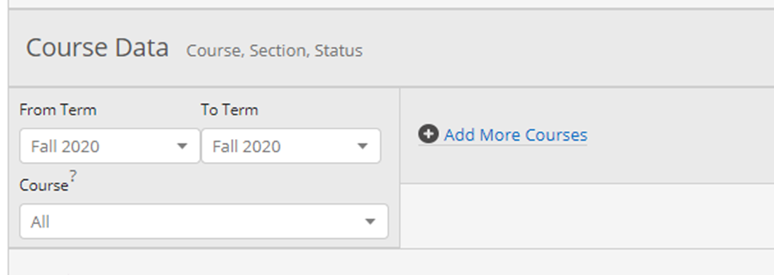
Search
Double check at the top next to your name that it shows the current semester.
Scroll down to Course Data

Slide 5
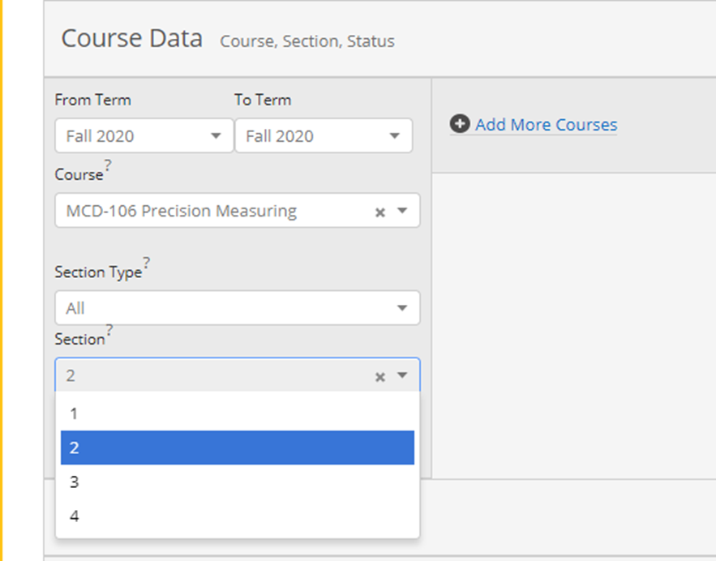
Search
Choose the class you are wanting to find the student for.
Choose the section or all sections.
Search

Slide 6
Search
At the top of the list (Unsaved Search) if will show you the filters you chose at a glance.
If you want to change it…choose Modify Search.
If the results are acceptable choose SAVE
Name your search. Tip-Put the semester in the name
Click Save Search

Slide 7
Search
Click on the List and Search Icon. All of your saved list will show for future use.
This will stay in your profile until you delete it.
BEST PRACTICE-Clean these up each semester

Slide 8
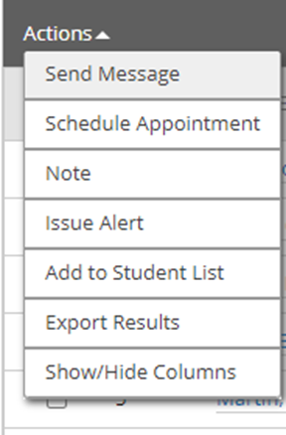
Search
Click the box next to the desired list
Click on the Actions after the list is open
Message students (Text and Email)
Issue an Alert (goes to Success Coach)
Export (if you need the list in a CSV for other projects)
Other options are not valid for Faculty
If you need assistance creating the saved searches, please email navigatehelp@wsutech.edu

